Slide 1


Slide 2


Unified University Management & Student Support Platform
Pre-Final Year Project Progress
Submitted by
Roll Number | Name
2301010289 | Vaibhav Vaid
2301010282 | Adeela Azeez
2301010300 | Himani Tyagi
2301010293 | Ashutosh Singh
2301010298 | Satdev
Faculty Mentor: Ms. Iflah Aijaz
Notes:
New Courses replaced with New Programmes

Slide 3

Project Overview
Universities usually manage academics, student support, and administrative work using different systems or manual methods. Students often need to check notice boards, emails, or visit offices personally to get information about attendance, exams, results, or grievances. This makes the process slow and confusing for both students and staff.
The Unified University Management & Student Support Platform is developed to solve this problem by providing a single web-based system for all university-related activities. It brings students, faculty, and administrators onto one platform where academic information, requests, and communication can be managed easily.
The system reduces manual work, improves transparency, and ensures faster communication. By using role-based access, each user gets only the features relevant to them, making the platform simple, secure, and efficient for daily university operations.
Notes:
New Courses replaced with New Programmes

Slide 4
Specific Objectives
To develop a centralized digital platform for academic management.
To reduce manual and paper-based academic processes.
To improve communication between students, faculty, and administrators.
To ensure secure storage and retrieval of academic data.
To provide a scalable and user-friendly system
Notes:
New Courses replaced with New Programmes

Slide 5
Key Features
Centralized student and faculty database
Role-based access (Student, Faculty, Admin)
Academic notices and announcements
Course and academic record management
Secure login and data handling
Web-based, easy-to-use interface
Notes:
New Courses replaced with New Programmes

Slide 6
Progress Summary
1. Frontend Development (React)
Implemented a global search system for easy navigation across the platform.
Built a notification center to manage and display system alerts.
Created reusable UI components to improve maintainability and consistency.
Developed dashboard analytics for visual insights and metrics.
Integrated an academic calendar feature.
Added dark mode support for improved user experience.
2. Chatbot Module
Implemented a modular backend architecture including:
Routes
Controllers
Services
Developed request–response handling for chatbot interactions.
Added basic error handling to ensure system stability and proper API responses.
Notes:
New Courses replaced with New Programmes

Slide 7
Detailed Progress – Development Phase
3. Backend Development
Backend infrastructure has been completely set up.
All required APIs have been developed and are functioning successfully.
Database integration completed using MongoDB Atlas.
Proper server configuration and routing structure implemented.
Notes:
New Courses replaced with New Programmes

Slide 8
Methodology
Research and Analysis: Study existing university management systems and identify challenges faced by students, faculty, and administrators in managing academic and administrative processes.
Requirement Specification: Define detailed functional and non-functional requirements for the Student, Faculty, and Admin modules based on the identified academic and administrative needs.
Design and Prototyping: Create system architecture diagrams, database schemas, and UI wireframes using tools such as Figma to visualize role-based dashboards and user interactions.
Development: Implement the platform using modern front-end and back-end technologies. Secure authentication, role-based access control (RBAC), and scalable RESTful APIs will be developed to ensure data integrity and system security.
Testing and Validation: Perform unit testing, integration testing, and usability testing to identify bugs, verify functionality, and validate system performance across all modules.
Deployment and Maintenance: Deploy the application using local or containerized environments (Docker).
Notes:
New Courses replaced with New Programmes

Slide 9
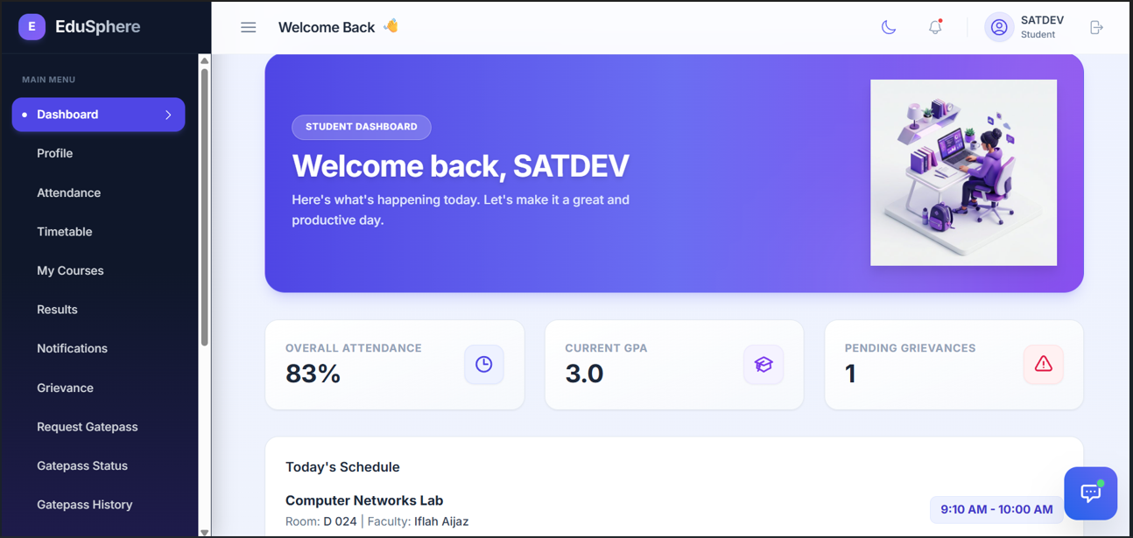

Prototype
Notes:
New Courses replaced with New Programmes

Slide 10
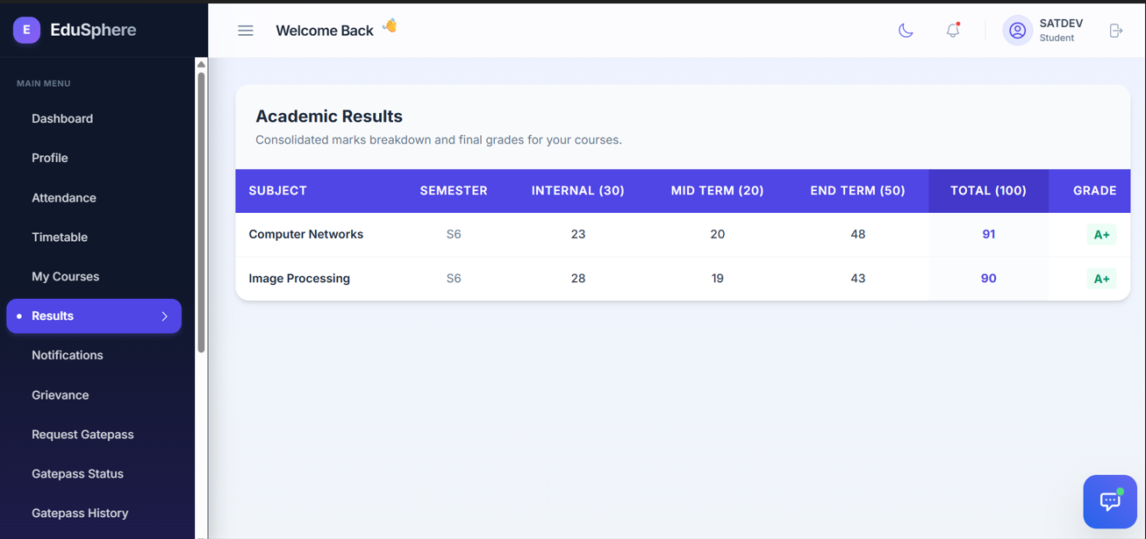
Prototype
Notes:
New Courses replaced with New Programmes

Slide 11
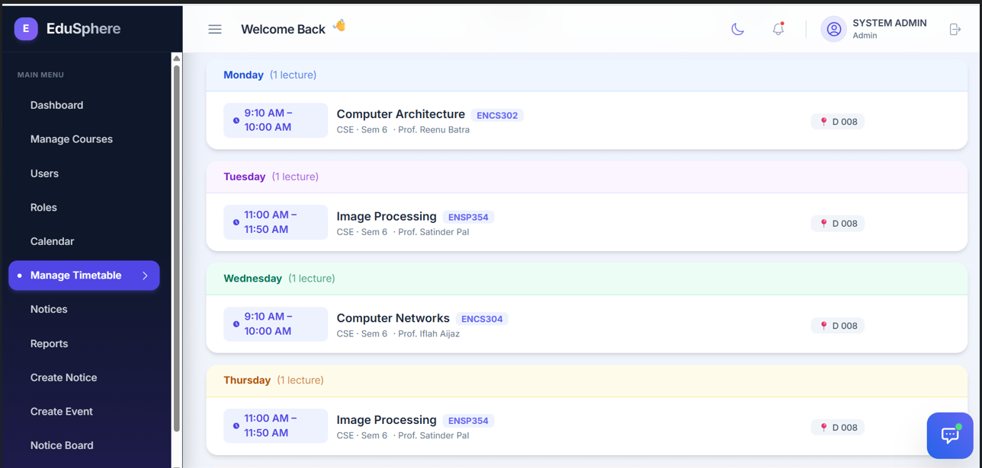
Prototype

Slide 12
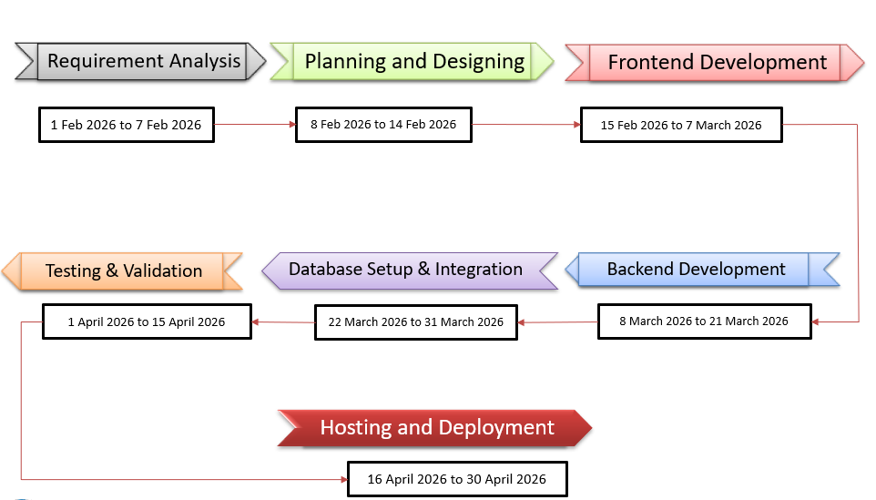
Project Timeline
Notes:
New Courses replaced with New Programmes

Slide 13
Project Usecases & Scope
Use Cases for Administrators:
Verification of safe administrators
Control roles and users
Make academic announcements and bulletins public.
Manage academic calendar
Monitor the grievance process
Create academic reports and attendance records.
Use Cases for Students-
Secure login and user registration
Review and edit your personal profile.
Analyze both overall and subject-specific attendance.
View the schedule and exam results.
Receive notifications and announcements
File complaints and monitor their progress
Notes:
New Courses replaced with New Programmes

Slide 14
Project Usecases & Scope
Use Cases for Administrators:
Verification of safe administrators
Control roles and users
Make academic announcements and bulletins public.
Manage academic calendar
Monitor the grievance process
Create academic reports and attendance records.
Notes:
New Courses replaced with New Programmes

Slide 15
Expected Results & Impact
Development of a centralized, secure, and role-based university management platform for students, faculty, and administrators.
Automation of academic and administrative processes such as attendance tracking, marks management, notifications, and grievance handling.
Reduction in manual workload and processing delays, leading to improved operational efficiency.
Enhanced transparency and accountability through real-time access to academic records and request status tracking.
Improved communication and engagement among students, faculty, and administration.
Accurate and reliable data availability supporting informed academic and administrative decision-making.
User-friendly and scalable system architecture that can support future enhancements with minimal cost.S
Notes:
New Courses replaced with New Programmes

Slide 16
THANK YOU

